Slide 1


Handwriting-Based Alzheimer's Disease Detection Using GNNs
Presented by Harshika Duhan | CSET-335: Deep Learning Project

Slide 2



Introduction
Alzheimer's Disease
Handwriting Patterns
A progressive neurodegenerative disorder with cognitive decline.
Indicative of subtle cognitive impairments and motor control issues.
Dataset Used
DARWIN dataset with 18 handwriting features across 25 tasks.

Slide 3

Research Objectives
Predict AD
1
Using Graph Neural Networks on handwriting data.
Model Comparison
2
GCN, GAT, GIN, and GraphSAGE architectures assessed.
Evaluation Metric
3
AUC-ROC selected due to class imbalance considerations.

Slide 4

Dataset Overview
Participants
Features
Data Balance
89 Alzheimer's patients
18 handwriting features extracted from 25 distinct tasks
Samples are slightly imbalanced between classes
85 Healthy controls
Total 452 columns per subject

Slide 5
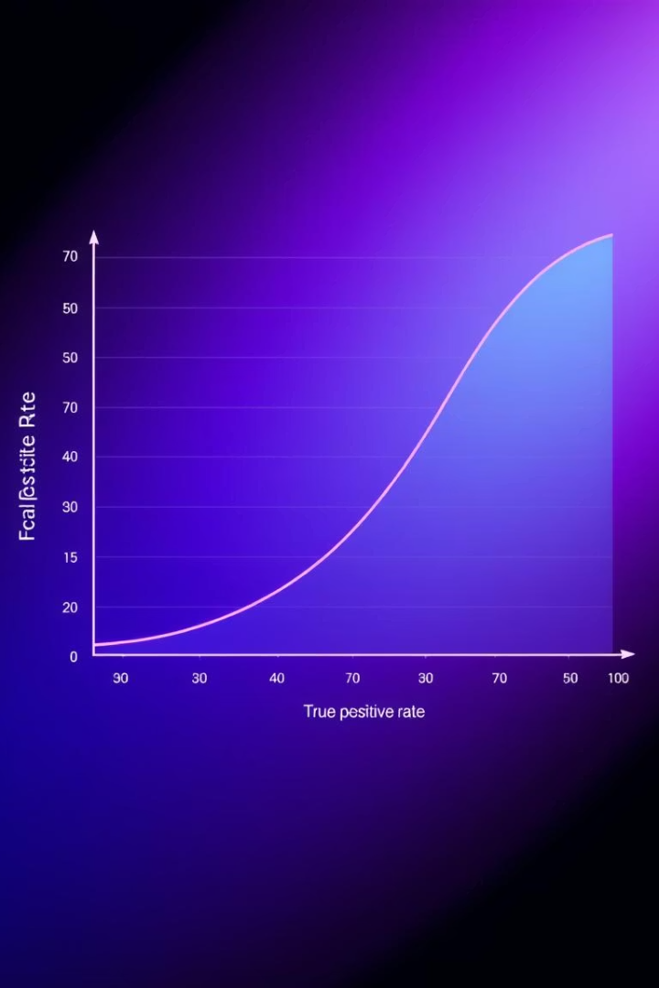
Evaluation Metric
Accuracy is unreliable due to dataset imbalance.
AUC-ROC provides a balanced evaluation of true vs. false positives.
Preferred metric for sensitive medical diagnostic classification.

Slide 6
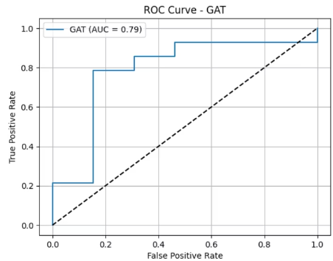
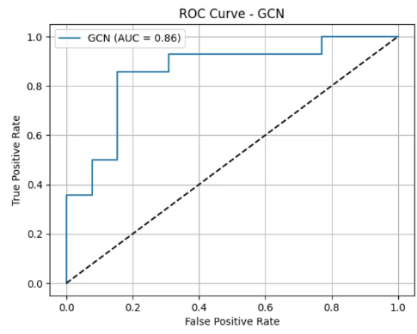


Results:
Fig 1: GAT
Fig 2: GCN
Graph Attention Network emphasizes weighted neighbor contributions.
Graph Convolution Network aggregates uniform neighbor features.

Slide 7
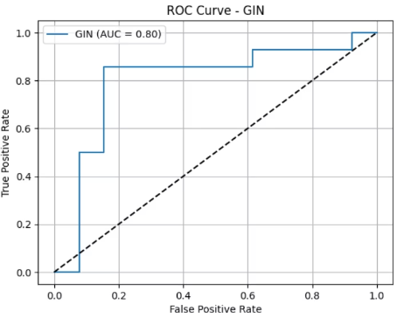
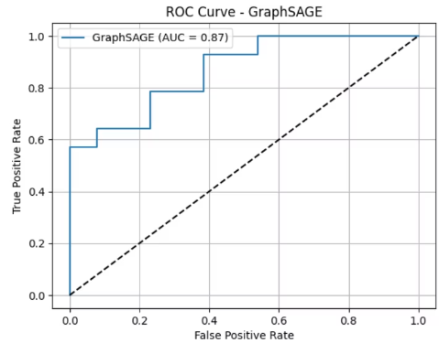


Fig 3: GIN
Fig 4: GraphSAGE
Graph Isomorphism Network - highly expressive structural learning.
Scalable sampling and aggregation for large graph datasets.

Slide 8
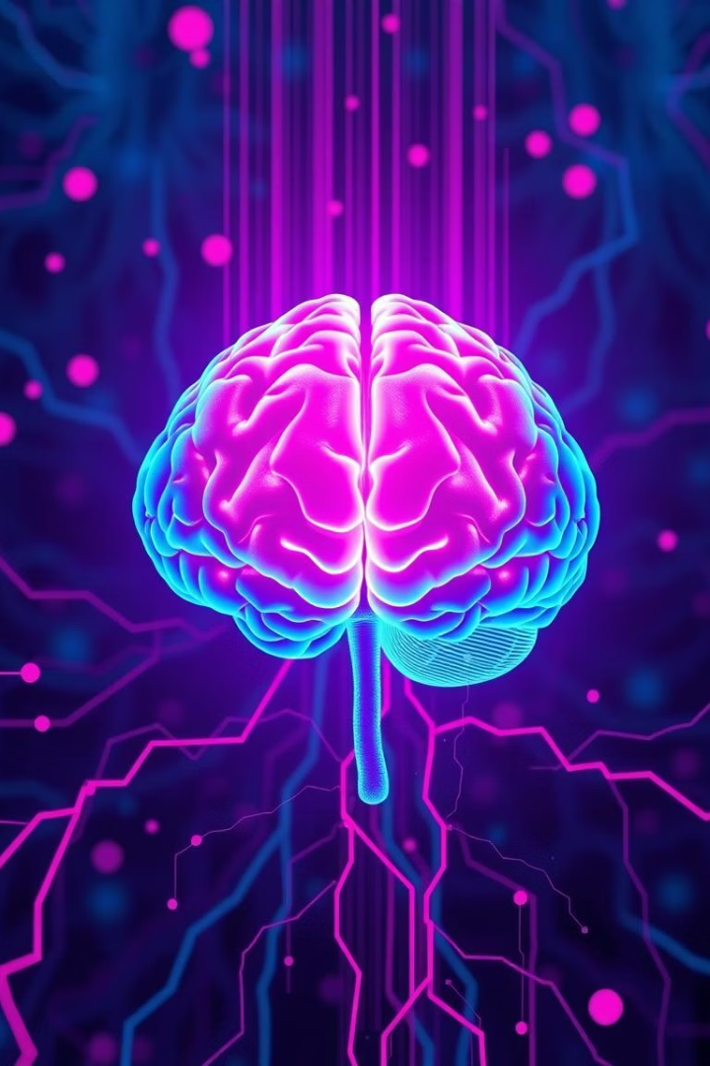

Performance Summary & Insights
Strong GNN Performance
All models showed effective classification capabilities.
GraphSAGE Excellence
Best at capturing complex graph relationships for AD prediction.
GAT Flexibility
Used attention to weigh neighbor importance dynamically.
GIN & GCN
Competitive alternatives providing expressive and stable learning.

